Slide 1
Project 2 - Sentiment Trading Model

Slide 2
Team Members (alphabetical order)
Azam Jiva
Gilberto Sanchez
Gisell Tavarez
Herman Gorovodskiy
Roberto
Yvette Liang

Slide 3
Executive Summary
The purpose of this project is to leverage machine learning, more specifically, natural language processing to generate a daily trade signal based on news sentiments.
Once a strong positive trade signal is generated, our model will put in an automatic buy trade at end of day.
A strong positive trade signal is referred to as a compound score.
To ensure the effectiveness of the model, we have layered in correlation analysis between daily historical compound score to its previous closing price and generated a total correlation score for stocks that we decided to trade.
Our trading model has returned 30% cumulative return when back testing past 2 year’s historical data of COP (ConocoPhillips).
We believe by feeding in more data points and continue enhancing this model, we will make the model more effective and achieve our trading target.

Slide 4
Concept
Project 1: Quantitative Model to Pick the best stock (we ranked stocks based on 5 important matrix and selected COP among other energy stocks)
Project 2: Trading Model. How do we trade this best stock? We leveraged Machine Learning – Natural Language processing to generate trading signals based on news sentiment. The machine learning assigned three values(Positive,Negative, Neutral)
Description: Stock trading based on headline news sentiment analysis
Motivation for development: Create a new model to use as a tool to use in trading strategy
User Story: Make a profitable trading model leveraging sentiment trading signals(BUY/SELL)
Notes:
We wanted to find out whether the outperforming stock we picked within an index in our last project had price action influence from outside sources
We decided that we would work with major new outlets such as CNN and the Washington Post to create a model to analyze sentiment based on articles published within any time frame. So essentially we wanted the ML to give us an insight on whether an article was positive, negative or neutral when it covered or mentioned any stock we wanted.
Once the ML library analyzes the headlines for sentiment, we wanted to pair it with a trading algorithm to give us buy and sell signals so we can profit off price action following the release of each article

Slide 5
Data Techniques
Data Source:
News API for New articles on selected stock
Yahoo Finance for stock historical price data
Data Source Selection:
Popular News API for news sentiment analysis
Yahoo Finance: Comprehensive historical trading related data
Python Libraries used for collaborating,collection and cleaning of data, exploration, and analyzation.
NLTK – Vader Library(Machine Learning Python Natural Language toolkit)
Sentiment Intensity Analyzer
Vader Polarity Scores(-1,0,1)
Pandas and Numpy
Google Colab

Slide 6
Approach-Step 1: Stock Selection and Sentiment Analysis
News Piece (News API)
Processing news via NLTK ML model
Sentiment Score- Compound score
Notes:
We selected the stock “ConoPhilips” based on the criteria we created in model in project 1 - wanted to add news impact on the returns
For Sentiment - first we thought to focus on one news published for e.g., NY Times API (articles covered by NY times were not much) - then we learned about Conocophillips has business around the world including australia and europe. So we choose a news aggregator API - News API.
We then process the news through the NLTK (one of the famous library to generate sentiment score for social media and news articles.

Slide 7
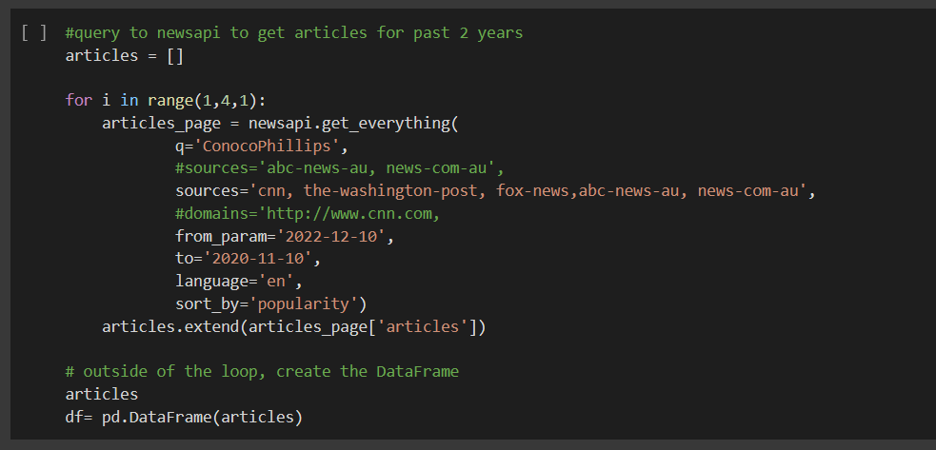
Demo – Sentiment Analysis
NewsAPI fetches articles that mention a selected stock
Fetches data from credible news sources such as CNN, Washington Post, New York Times, Fox News, etc.
Ability to pick start and end dates and you can sort articles based on popularity

Slide 8
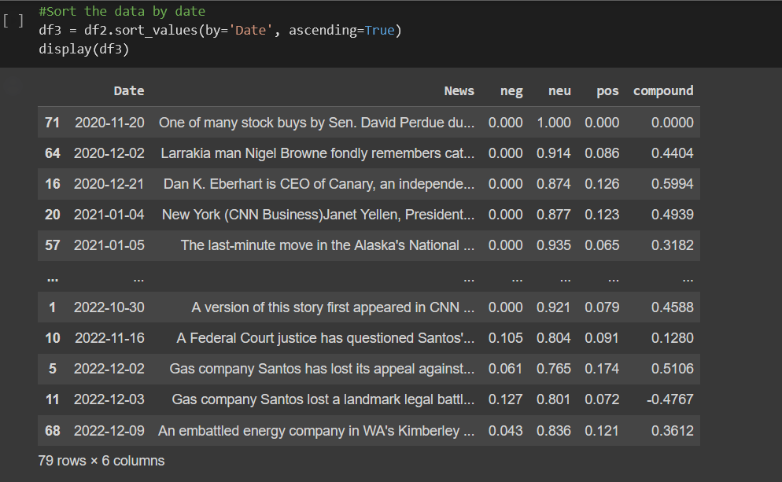
Demo – Sentiment Analysis
Fetched data is converted into a dataframe
Vader NLTK runs through every article pulled to create a polarity score based on words in each article
Compound score is the final sentiment score. The closer it is to +1, the more positive the sentiment. The closer it is to -1 the more negative the overall sentiment is.

Slide 9
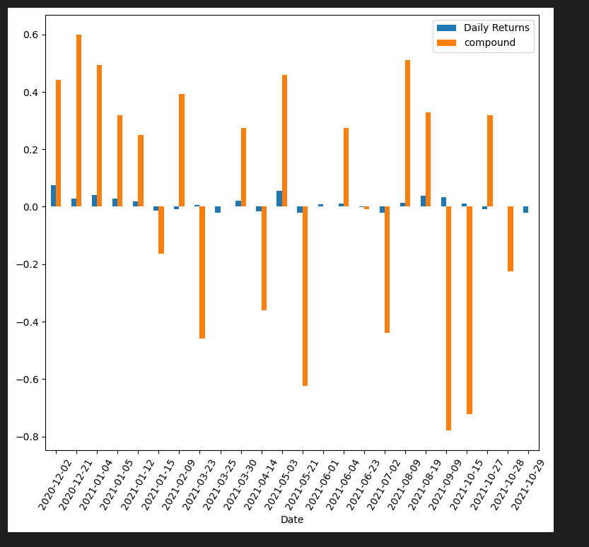
Demo – Sentiment Analysis
Mapping sentiments score to daily returns
Sentiment scores reflected the movement in daily returns.
Trend: Returns were positive on positive news published during the period 12/20 - 1/21.
Strategy to correlate the returns based on positive news.

Slide 10
Approach -Correlating Sentiment to Returns
Pandas and NumPy
Examined correlation between the compound score and T+2 daily returns
hvplot

Slide 11
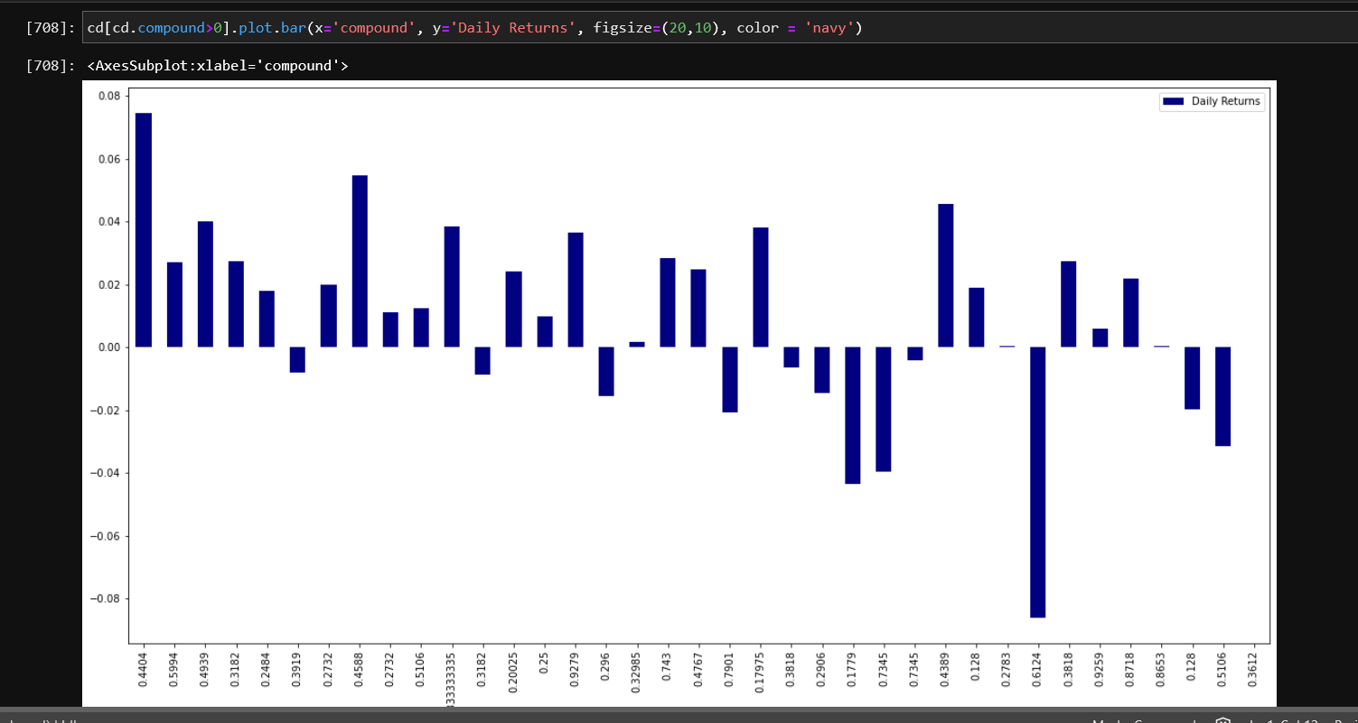
Demo – Correlation

Slide 12
Approach - Backtesting using 2 years of data
Pandas and NumPy
Examined correlation between the compound score and T+2 daily returns

Slide 13
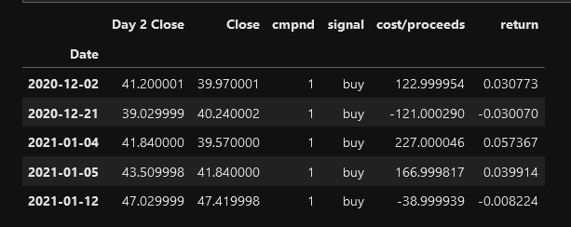
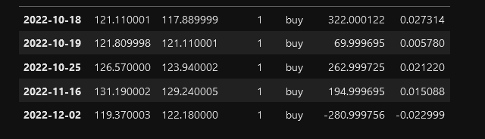
Backtesting
Trade on Positive Sentiment - Positive Compound Score
Buy 100 shares at Close on day of News Content
Sell 100 shares at Close Next Day
Calculate Proceeds and % return

Slide 14
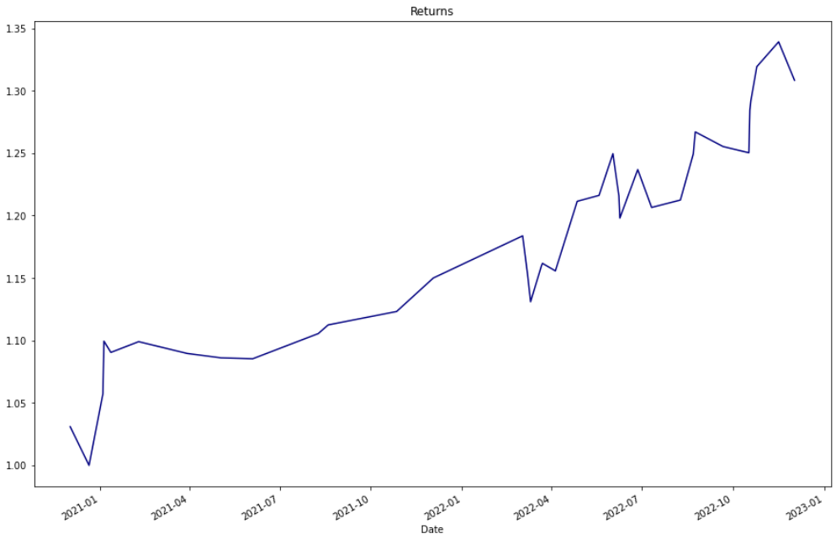
Back Test Result
$2,107 Profit based on 100 share trades
30.8% Cumulative return

Slide 15
Looking Ahead
1. Machine Learning
Utilize multiple libraries to enhance the NLP
Convert Sentiment Analysis model into a Command Line Interface that will allow users to pull any stock, with a start and end date
Correlation Score that is produced will help users determine whether they would want to continue with trading the stock they have chosen.
Incorporate more data points. Perhaps use minute data.
2. Future Uses

Slide 16
GitHub repo - https://github.com/ggorovod/Team_Project_2
Colab - https://colab.research.google.com/drive/1dcQS7QjgH5gPAV-BdCdqWn_2uhp2h5Qg#scrollTo=adgEnlgsgu_u

Slide 17
Thank You!

